Slide 1
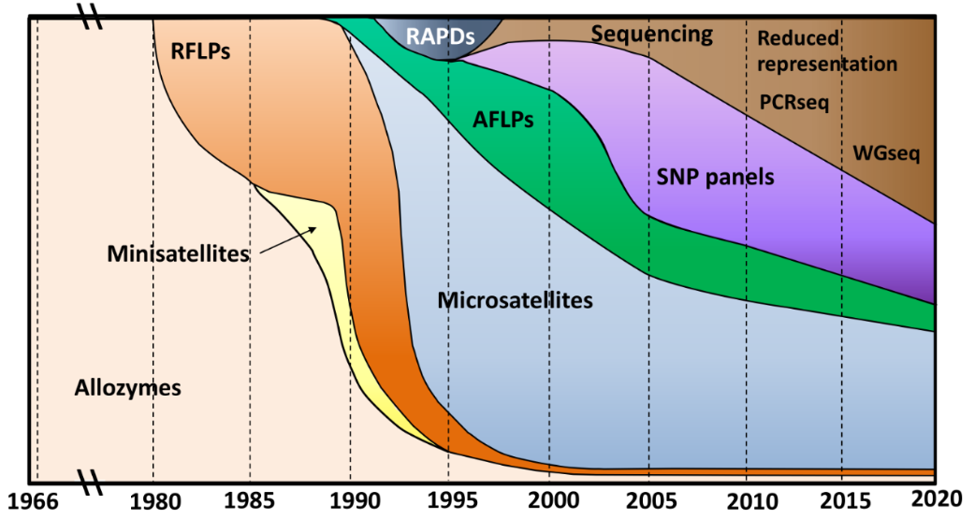
Genetics and Genomics: Data Types
Allendorf et al 2023

Slide 2
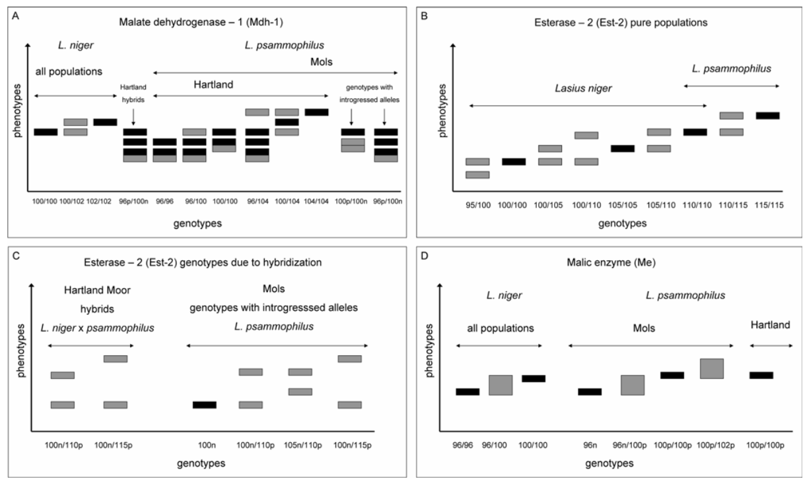
Allozymes and RLFPs
CTGACG
GCAGTC
Enzyme configuration differences (allozymes)
Restriction fragment length differences (RFLPs)
Both old, rare today.
Low power.
5-20 loci
Van der Have et al 2011

Slide 3
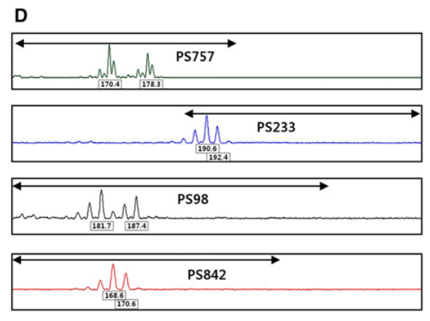
Microsatellites
ATCATCATCATC
x4
ATCATCATCATCAT
x5
ATCATCATCATCATATC
x6
Lee et al 2011

Slide 4
Microsatellites
ATCATCATCATC
Variable length repeats
Highly polyallelic
Easy
Cheap
5-20 loci
Still used today!
x4
ATCATCATCATCAT
x5
ATCATCATCATCATATC
x6

Slide 5
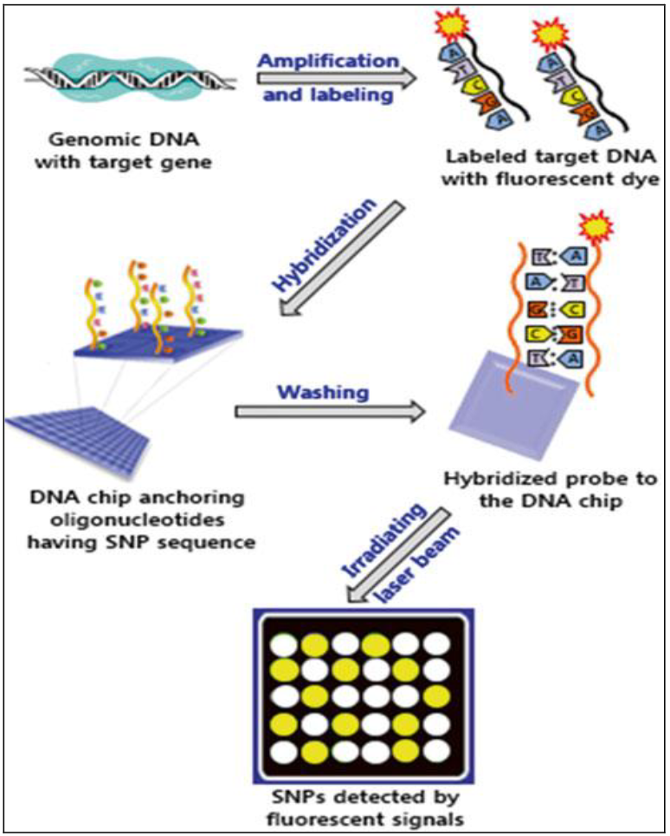
SNP panels/SNP chips
CGGACTACG
CGGAATACG
Single-nucleotide Polymorphisms (SNPS)
Only two alleles per locus
Relatively cheap
Need to be developed
Higher level of technical expertise
1k – 100k+ loci
Mishra et al 2017

Slide 6
Reduced Representation
CTGACG
GCAGTC
SNPs/structural variants, etc.
Can target random areas near cut sites (RAD)
Many exciting flavours!
Can target expressed or specific areas (sequence capture)
1k-100k+ loci
Fairly cheap
No development needed for some types
RAD variants
Greatly benefits from a reference genome
Great for studying patterns of diversity genome wide in non-model organisms
Can pool individuals to save money
No individual data, just population level

Slide 7
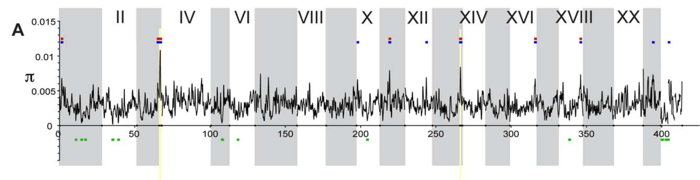
Hohenlohe et al 2010

Slide 8
Whole-genome sequencing
SNPs/structural variants, etc.
Essentially everything barring tough-to-sequence regions
100k – 10M+ loci
Often expensive
getting cheaper over time!
No development needed
Greatly benefits from a reference genome.
Excellent for studying patterns of diversity genome wide
The gold standard

Slide 9
RNA-seq
Central Dogma of Molecular Biology:
DNA -> mRNA -> Protein -> phenotypes
Coding
Regulatory
Non-coding (“junk”)
Great for looking environmental effects on expression
Great for looking for changes only in coding regions
Can do a great job of population assignment in some cases
Cannot assume things are neutral
Complicates population genetics
Tricky, somewhat expensive

Slide 10
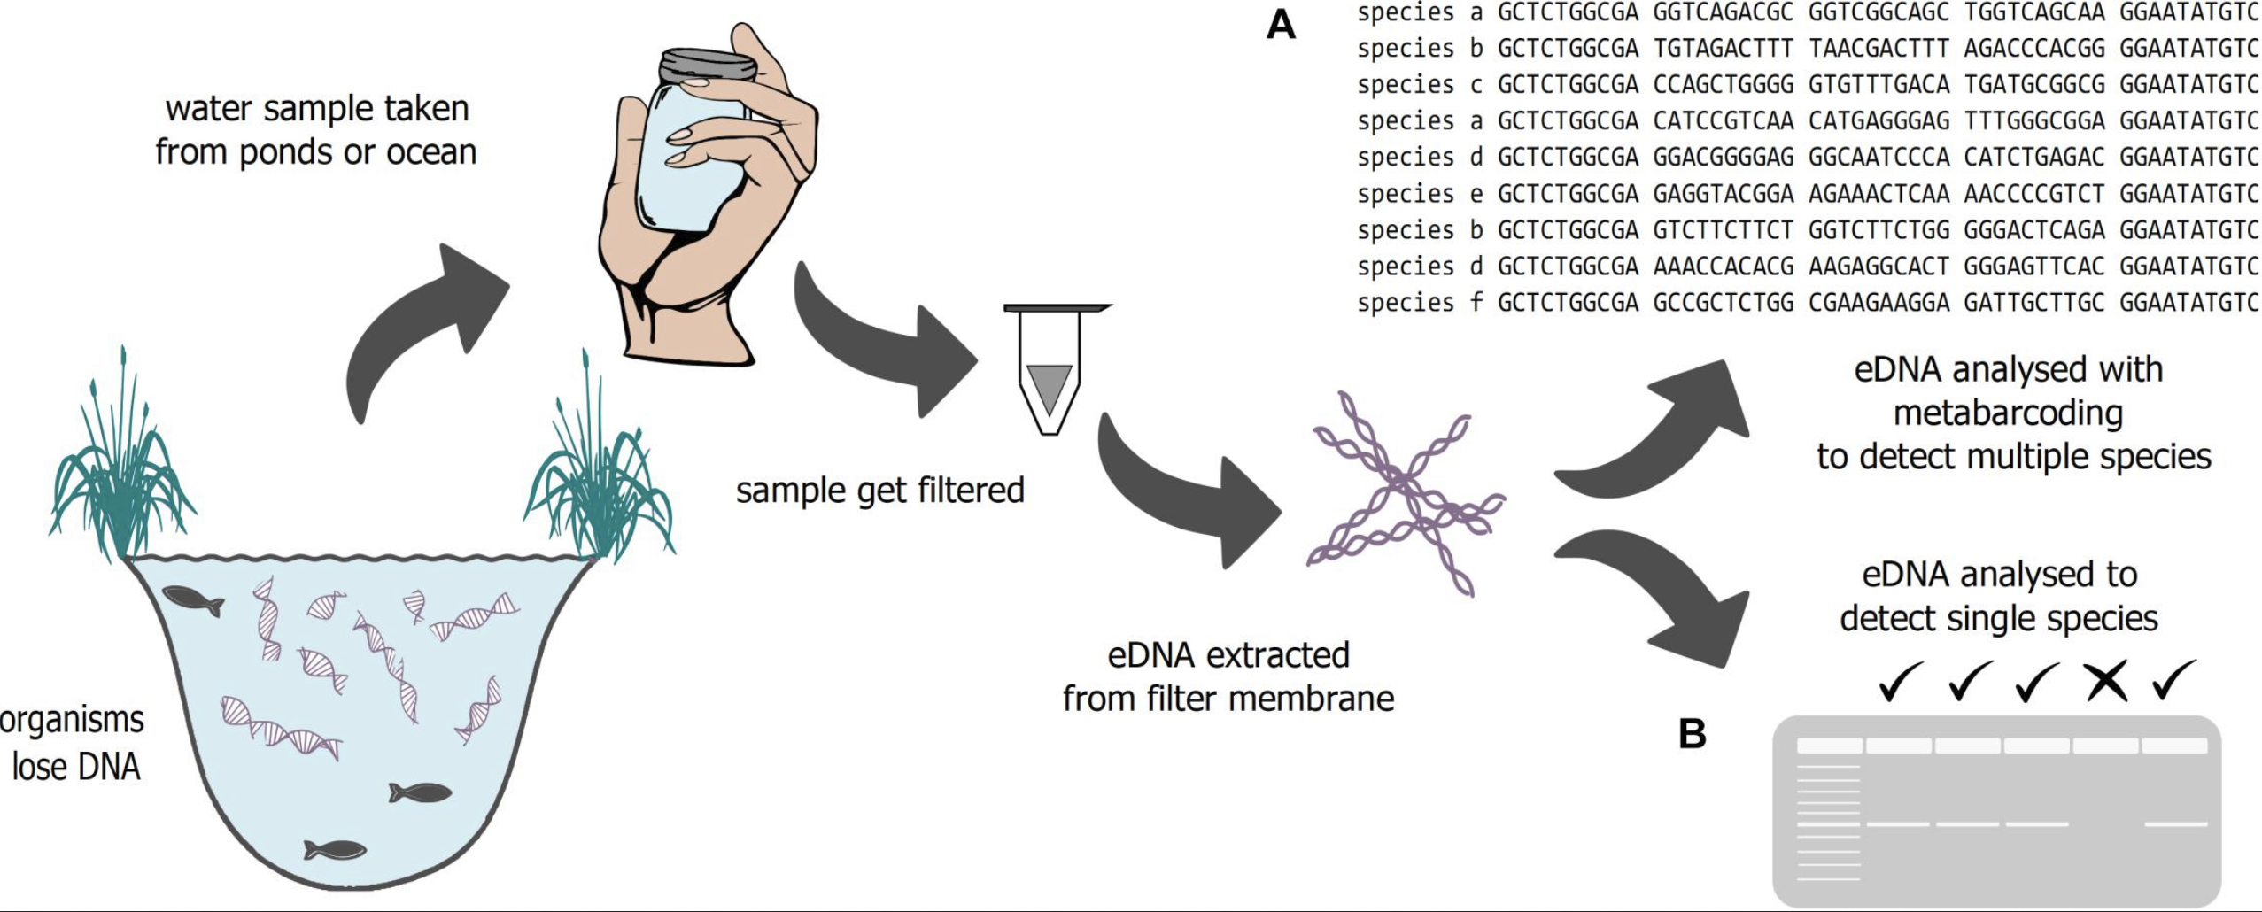
eDNA
Schadewell and Adams 2021
Don’t need to catch your study species
Can assess species composition
Great for species detection
Hard(er) to do population genetics
Depends on types of samples!
Data quality is often lower

Slide 11
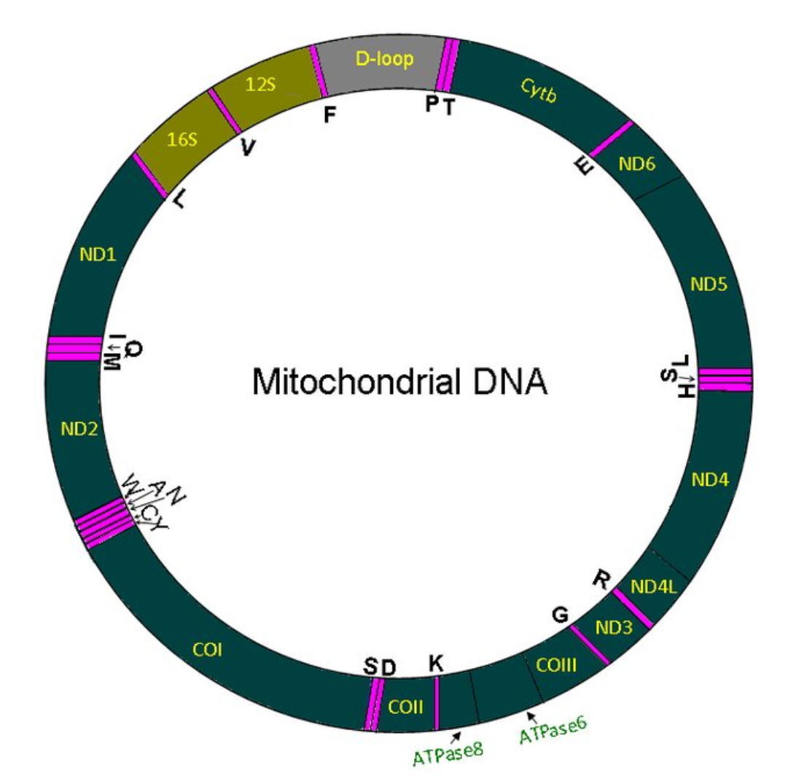
Mitochondrial DNA
Cheap and fairly easy
DNA lasts longer
Way more copies!
Both well conserved regions and some with faster mutation rates.
Excellent for species identification!
Raju et al 2011

Slide 12
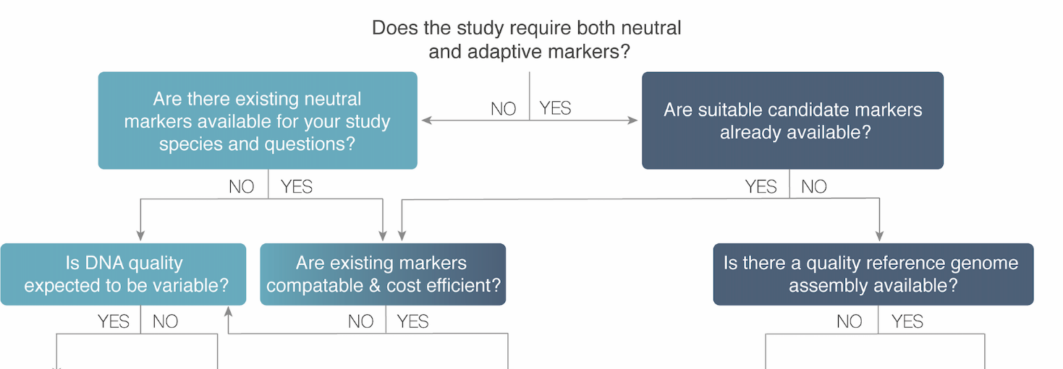
Limited funding and tech?
Consider microsats
Can’t sample your organism directly?
Consider eDNA
Interested in expression?
Consider RNAseq
Need neutral markers only?
Consider reduced representation/RAD
Need neutral and adaptive?
Consider RAD (mid resolution) or WGS (high resolution)
Schiebelhut et al in review: Practical guidance in conservation genomics: from study design to application

